Slide 1

Student survey · 40 responses
Student Use of Artificial Intelligence in Education: A Descriptive Survey Analysis
A survey of 40 students on how they adopt, perceive and evaluate AI tools in their academic work.

Slide 2
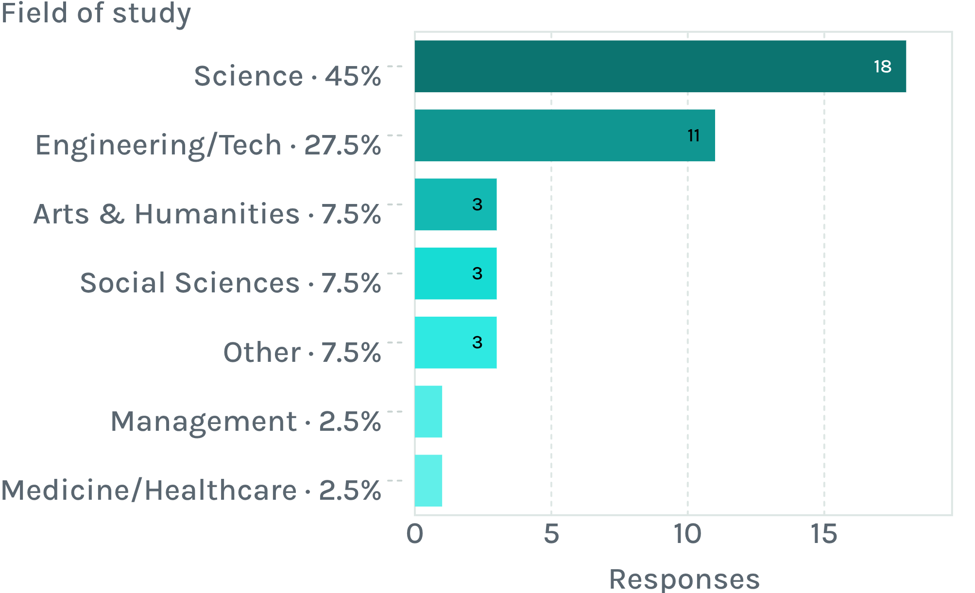

Survey design
Descriptive survey of 40 students, mostly from science and engineering
72.5%
Science and engineering
Aim: use, tools, frequency, purposes, concerns and policy views.
Design: reported patterns and perceptions; not cause.
Analysis: frequencies, percentages and qualitative themes from open-ended comments.

Slide 3
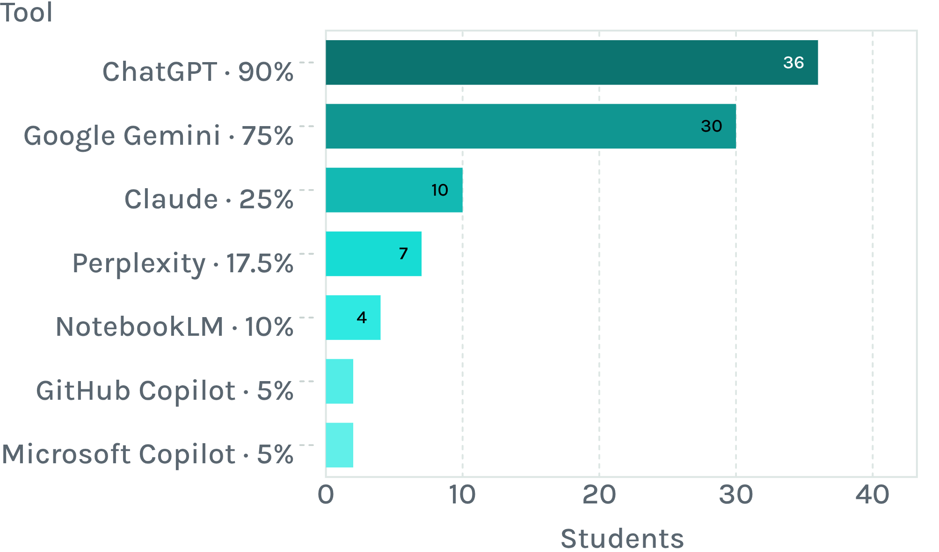
Tools and frequency
Chat GPT and Gemini dominate, and 42.5% use AI several times a day
Use frequency | n
Several times a day · 42.5% | 17
Several times a week · 27.5% | 11
Once a day | 4
Occasionally | 6
Once a week | 1
Rarely | 1
Many students combine several platforms.

Slide 4
Students use AI across every stage of academic work
Most visible purpose
Understanding difficult concepts
Solving problems, assignments, exam preparation, summarising, research, coding, writing, idea generation, translation and presentations.
Preferred role: a learning assistant that explains concepts, improves existing work and supplies ideas.
Some worry that using AI mainly to finish tasks quickly reduces independent thinking.

Slide 5
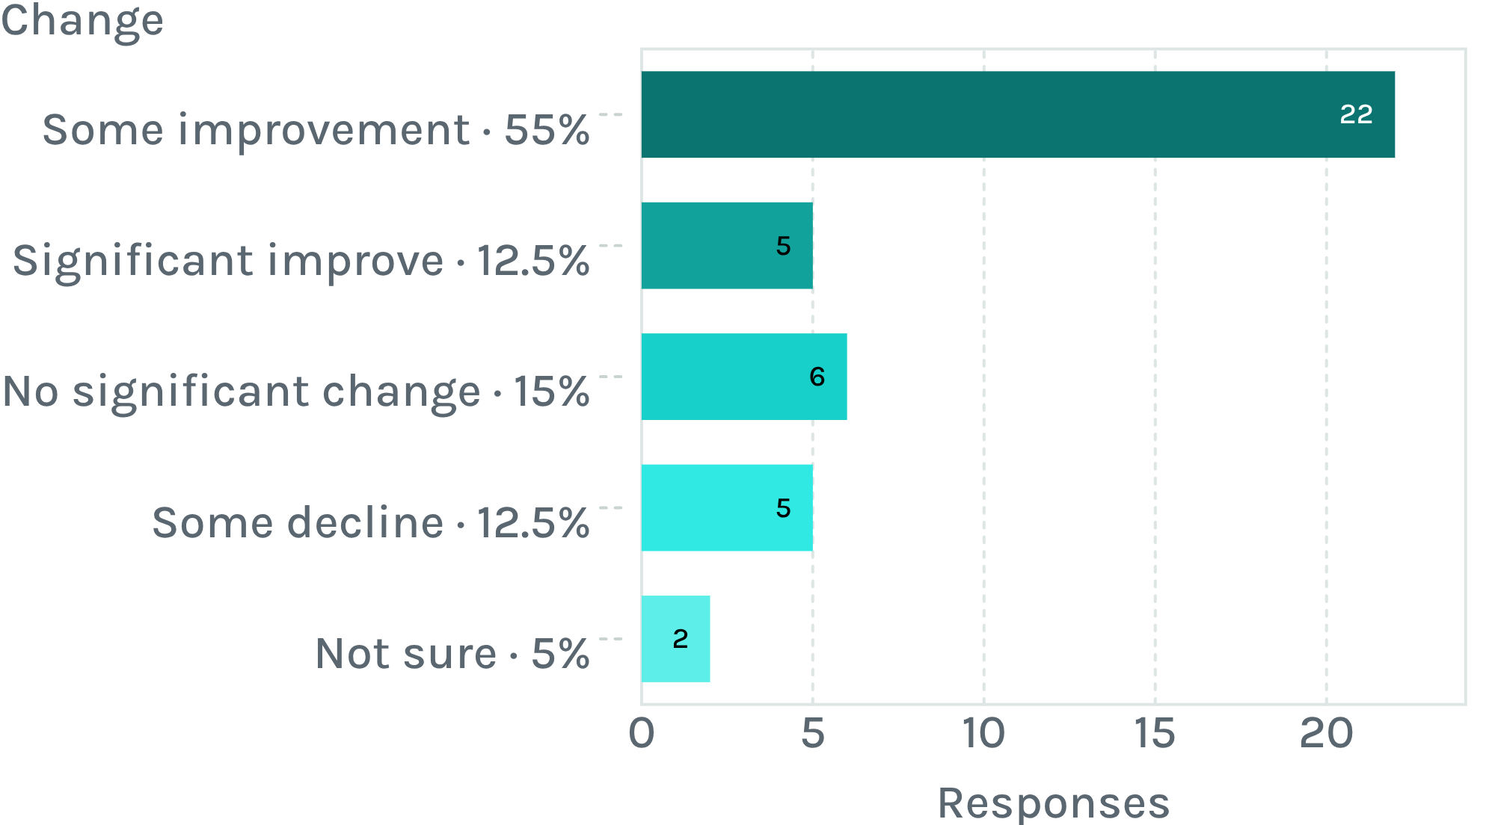
Perceived performance
67.5% perceive improved performance, but this is self-reported
Verification varies
From always to rarely; some students usually do not verify.
Sources used: textbooks, academic websites and journals, search engines, official sites, teachers and other AI tools.
Perceptions, not measured grades; no evidence that AI caused the change.

Slide 6
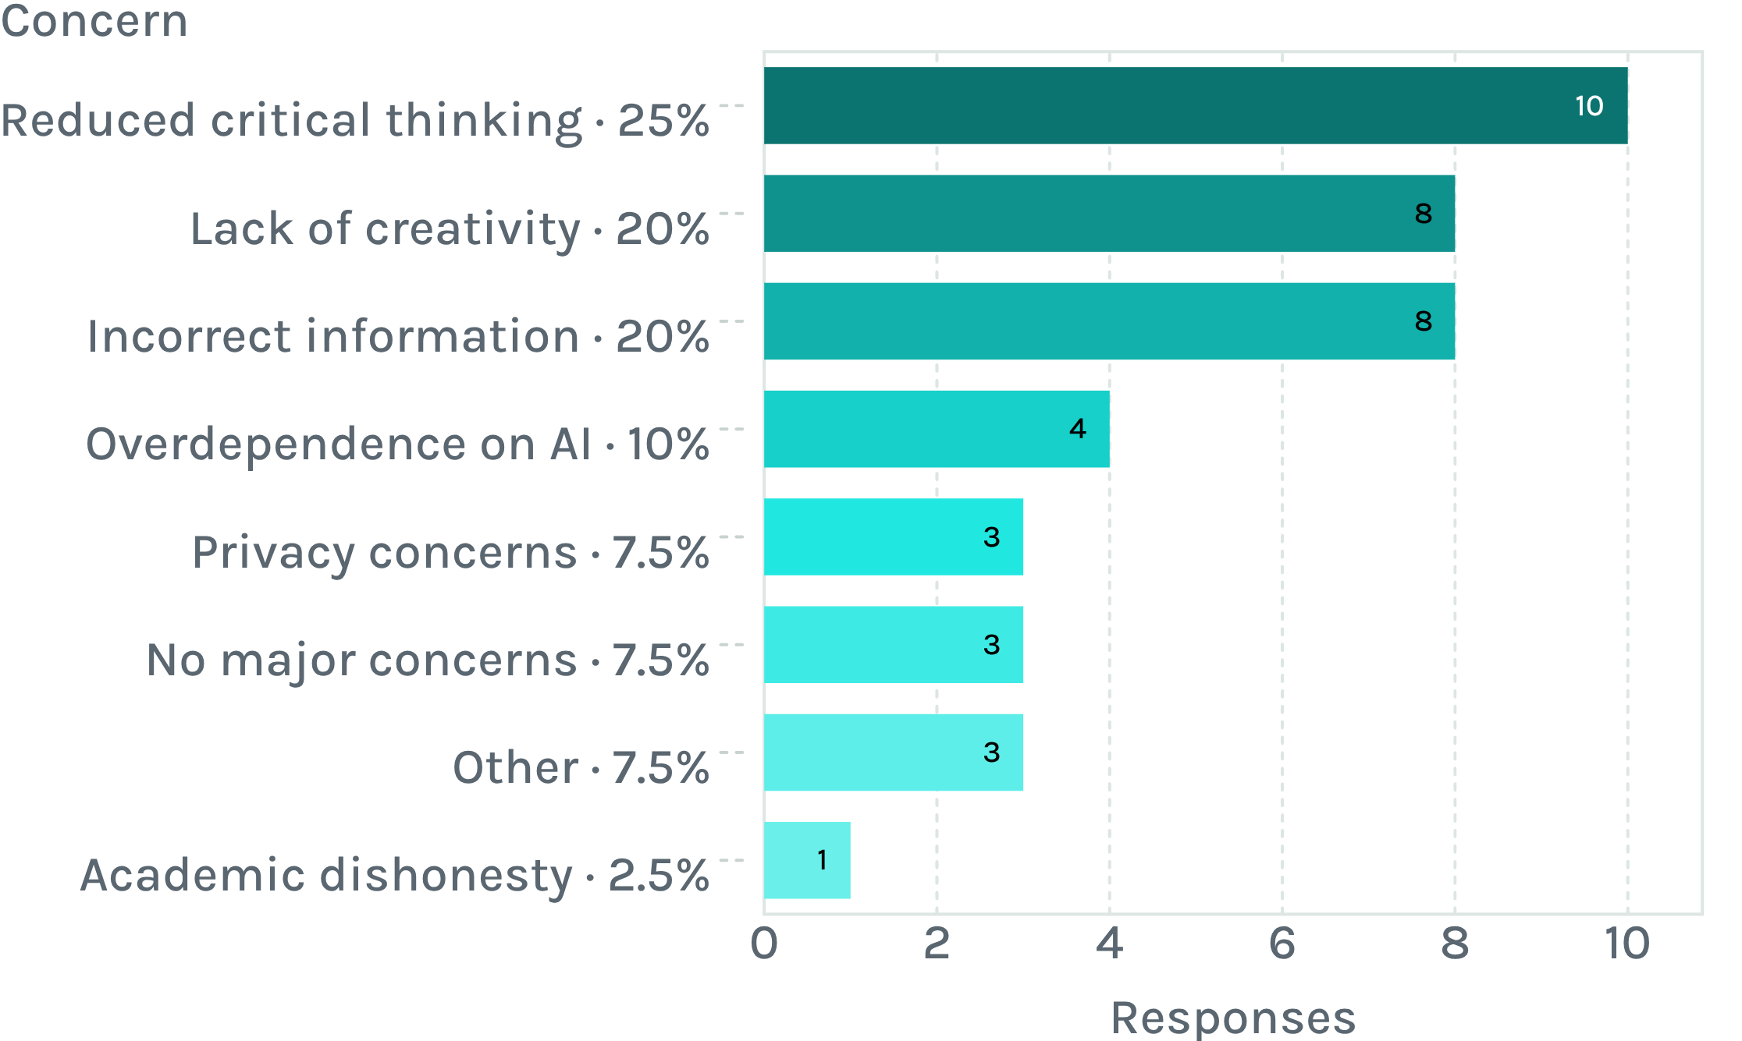
Concerns
Reduced critical thinking is the top concern
65%
Top three concerns: 26 of 40 responses.
Students call AI a “double edged sword”: useful, but heavy reliance may weaken independent thinking.

Slide 7
College policy
87.5% want AI allowed in college, mostly with clear guidelines
Policy view | n | %
Yes, with clear guidelines | 23 | 57.5
Only for certain academic activities | 9 | 22.5
Yes, without major restrictions | 3 | 7.5
Not sure | 4 | 10
No | 1 | 2.5
87.5%
35 students support some form of permission.
Most expect AI to stay relevant to education; acceptance does not mean unrestricted use.

Slide 8
Responsible use
Five principles of responsible AI use, read from the survey
Understand before depending: grasp difficult concepts while staying engaged.
01
Assistance, not replacement: support learning, not substitute for independent thinking.
02
Verify important information: incorrect information is a top-three concern.
03
Maintain originality: eight students flagged lack of originality.
04
Avoid excessive dependence: four students named it; open comments echo it.
05

Slide 9
Conclusion
Students see AI as a powerful tool whose value depends on how it is used
Clear guidelines, verification, originality and personal responsibility keep independent thinking at the centre of student work.
Limits: self-reported data, a sample of 40, descriptive only, so no causation.
Data source: the 40-response student survey only; no external sources used.

